Slide 1

Data Driven Education
Discussion Forum Subteam
Presentation 2 - 03/15/2023
Notes:
Jisan

Slide 2
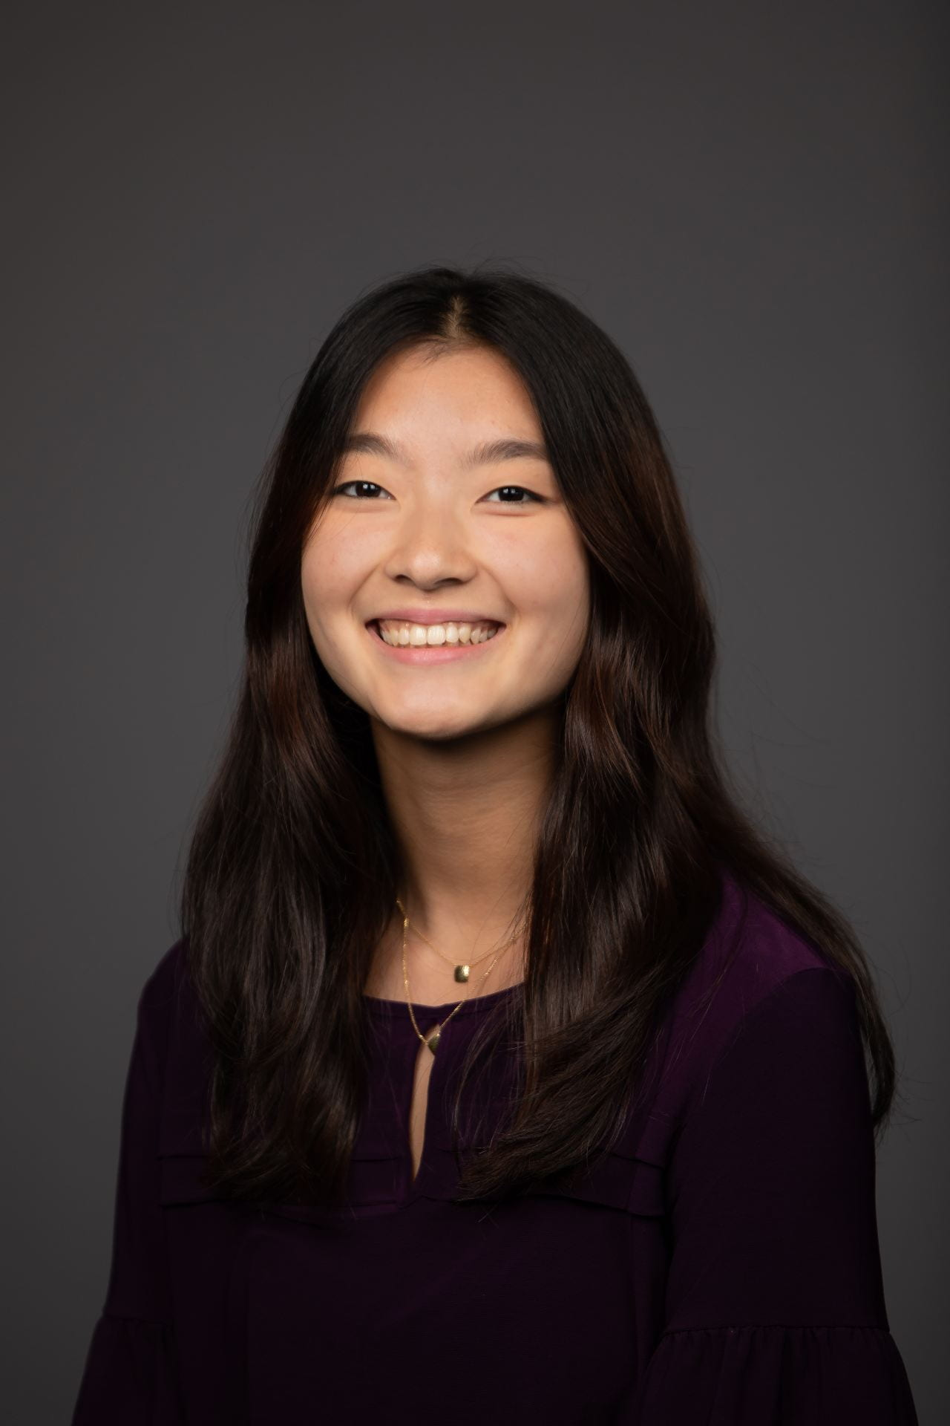

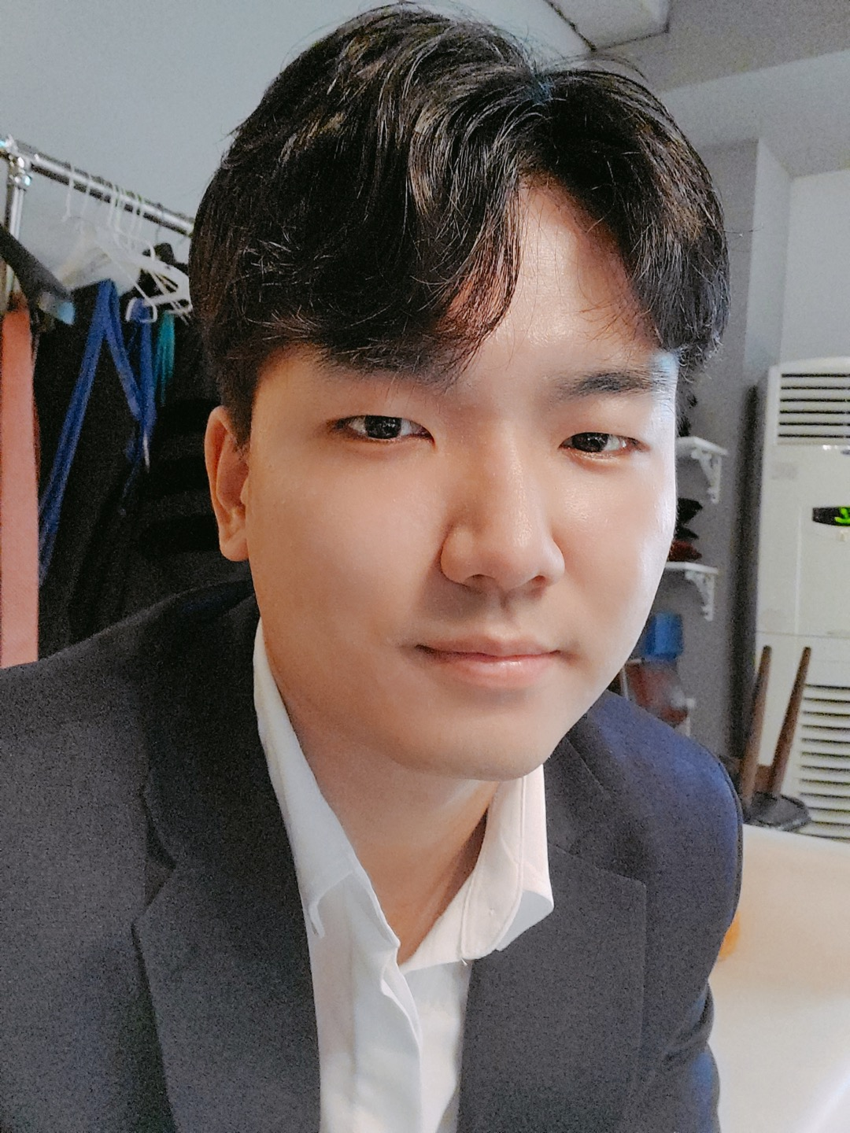
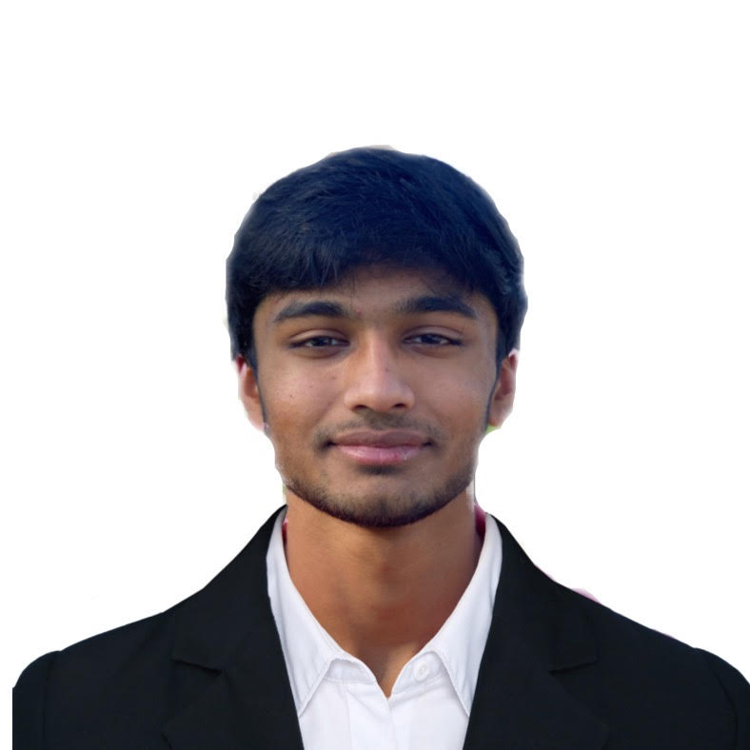
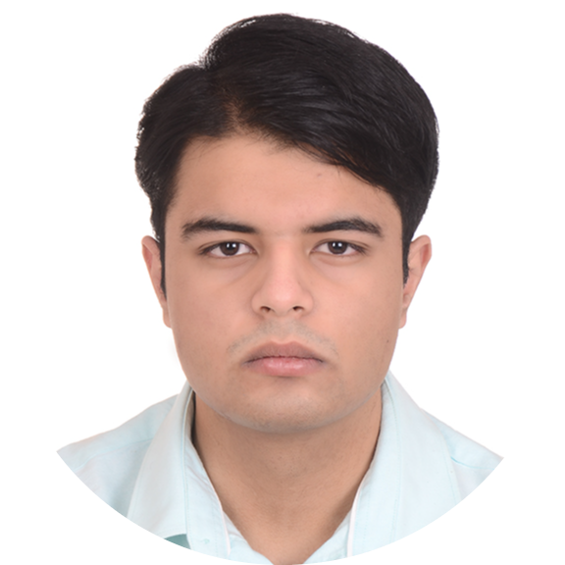
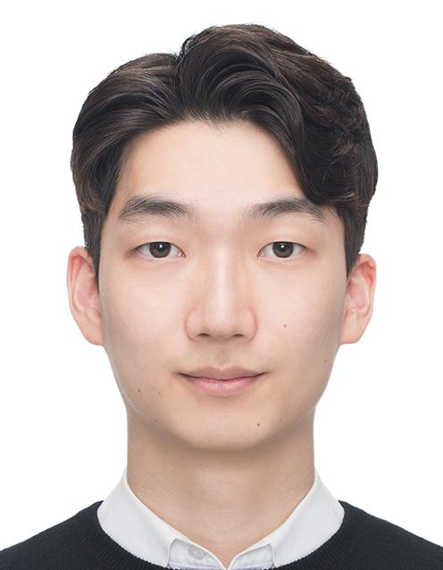
Team Members
Emily Cai
Data Scientist
Hyun Soo Kim
Data Scientist
Jisan Park
Project Manager
Ankit Mishra
Front-end
Web Developer
Youngwook Kang
Back-end
Developer
Rohan Karthik
Data Scientist
Notes:
All

Slide 3
Introduction
Discussion forums
  main source of interaction in MOOCs
Student interaction
  Aspect-Based Sentiment Analysis model
  Seeded Topic Modeling
Activity on forums indicative of student engagement and interest
Goal: Complete the applications of our dashboards to provide more accuracy and insights for our instructors
Notes:
Jisan
Discussion forums are the primary source of class interaction in an online asynchronous course. ABSA and Seeded topic modeling are used to increase student interaction. The activity on these forums can be used as an indicator for assessing students’ engagement and understanding in the course.
Therefore, our goals are to complete our dashboard for two courses to provide more accuracy and insights for our instructors.

Slide 4
Progress till now
Category | Accomplished | Next Goals
Web Dev | A dashboard has been created with dummy data that shows what and how information will be presented to users. Developed two dashboards for each course | Research API for Ed Discussion Improve the dashboard Utilize new UX research for our specific tools Fill the dashboard with the result from D.S team
UX Research | Summary document with user needs for instructors based on thorough interviews | Conduct additional interviews specifically to our outputs – ABSA and topic modeling
Data Science | Implemented Seeded Topic Modeling with each course data Graph for metacognitive presence | Increase the accuracy for each model Utilize the graphical information Transfer the data result to Web-dev team
Goals as a Project Manager:
Have clear deliverables each week for team members to make things concrete
Be a resource for all members of the team
Bridge the gap between Web-Dev team and Data Science team
Notes:
Jisan
Those are our team’s progress. Our web-dev team has developed two dashboard for each course, they will have an interview with TAs and utilize the UX design based on that. As soon as the result from the data gets ready, they will fill in the dashboard with actionable infos.
Data science team has implemented seeded topic modeling with each course data. The next goal for Data science team is to utilize the graphical information and transfer the data result to web-dev team.
My main goals are to have clear deliverables each week for team members and bridge the gap between two teams.
Next, Data science team will present their progress in detail.

Slide 5
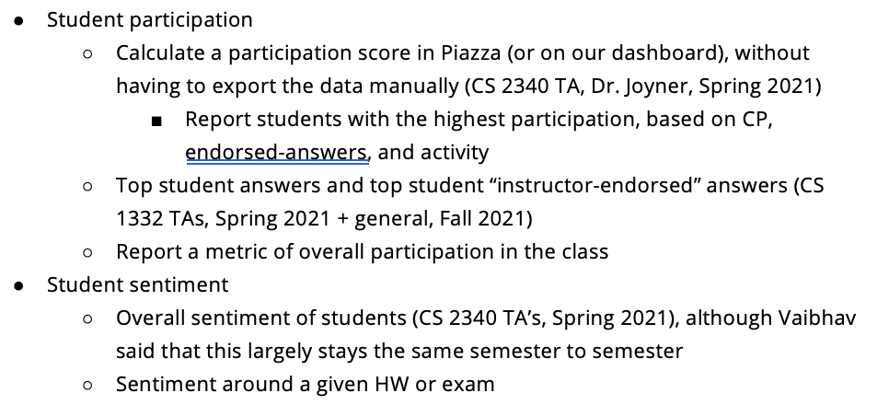
Focus for this semester
Research
  Interview professors and students
    Identify primary, secondary and tertiary needs
    Focus interviews to the specific tools that we are developing
Development
  Two separate dashboards
    (ML & CS 1301)
    Sentiment Analysis
    Topic Modeling
  Metacognitive data
    Visualization
Project Management
  Integrating topic modeling and Aspect-Based sentiment analysis in the dashboards
  Bridging the gap between the Web-Development team and the Data Science team
  Research on user needs for this dashboard.
    Supplement research done by previous subteam members by asking more questions with a specific focus on the tools that we are developing
    Bring back focus to Community of Inquiry Framework
Notes:
Jisan

Slide 6
Data Science

Slide 7

Review of Research Questions
Based on the community of inquiry framework, what are some useful metrics for student engagement and performance in an asynchronous online classroom?
  how can we use the user feedback from last semester and expand our research to understand specific applications for the models we are developing?
  how can we improve upon the accuracy of the models we've already developed without quantified indications?
How can we design a web app that can provide actionable insights to the instructor?
  how can we make the web app user-friendly and compatible with different devices?
Notes:
Emily
Here is a review of our research questions
- fortunately, we've been making progress toward answering each question
paraphrase question. Through our use of different data science methodologies (discussed in next slide), we are analyzing various data to formulate potential metrics and answers for measuring/improving student engagement
paraphrase question (we've been expanding our research by for example exploring different types of topic modeling and seeing which one provides more promising and reliable models for instructors to use, and we will continue to expand our research
paraphrase question (we cannot actually base our accuracy of the models off of percentages or statistics, so we are trying our best to improve accuracy of these models based on their relevance/importance and I'll talk about that later)
two dashboards are still in the process of being created (will be shown in later slides), and the data science team will try their best to provide the web-dev team with useful insights from our created models/data results.
while the dashboards are being finalized we will focus on how to make the dashboards user-friendly and compatible with various devices

Slide 8
Data Science Updated Big Picture
Analyzing CS1301 and CS6601 Discussion Forums Data
Replacing unsupervised topic modeling with guided topic modeling -> increased accuracy determined by more relevant topics outputted by models
Connecting student sentiment/attitude in education with ABSA
Visualizing the effect of metacognitive presence in a classroom
Cognitive Presence
Metacognitive Presence
Data Science
Topic Modeling
Aspect-Based Sentiment Analysis
Notes:
Emily
From our CS 1301 (Intro to Programming) and CS6601 (AI) data from ed and piazza, we are using Topic Modeling and ABSA to output data that we can analyze. With this data, we are trying to pinpoint indications of student engagement to provide useful data to instructors in the dashboards
Last semester, the data science subteam utilized unsupervised topic modeling (issues with accuracy), and this semester we've decided to replace this with guided topic modeling. The accuracy seems to have already increased with our models, which are outputting more relevant topics from the discussion forums
topic modeling (scans a set of documents and clusters word groups and similar expressions together to pinpoint what students are mainly discussing)
Though we are focusing on topic modeling right now, we are still interested in using Aspect-based sentiment analysis (ABSA) to examine student sentiment towards certain aspects in education
In terms of metacognitive data, we are focusing on visualizing the effects of this presence in a classroom setting, and this will be elaborated on later in the presentation

Slide 9
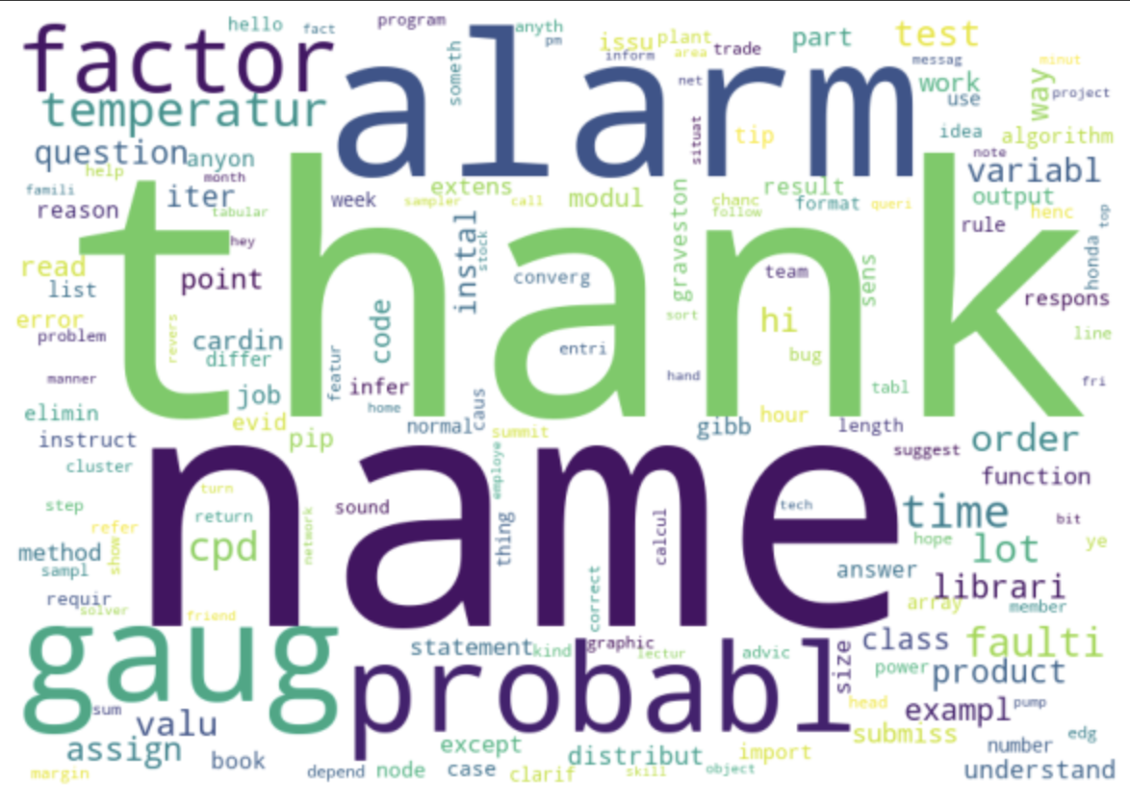
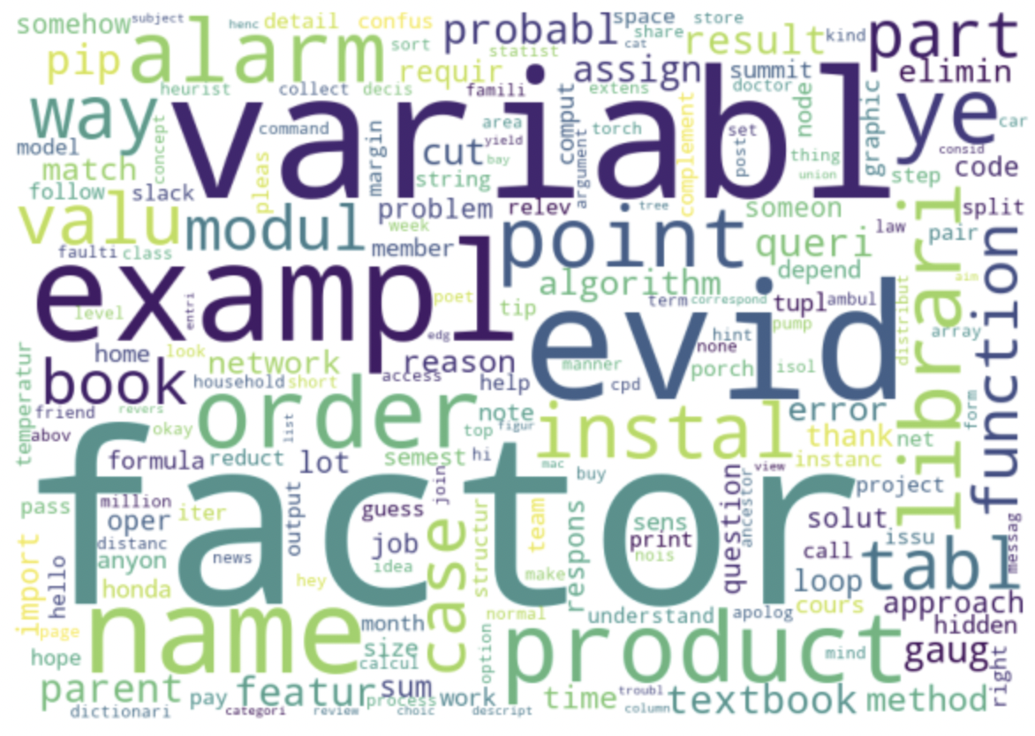
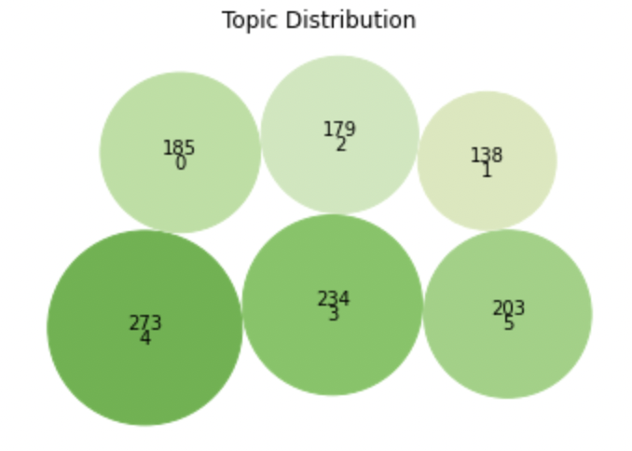
Topic Modeling
Topic Modeling - unsupervised
  scan documents, detect words, cluster groups
  should be aware of dominant topic
  limitation: the top topic was irrelevant to the course contents
Visualization on Piazza data
Notes:
Harriet
Topic Modeling is unsupervised ML technique that can scan a set of documents, detect words and phrase patterns within document, cluster word groups, and classify document by topic. We expected that Teaching team is aware of what students mainly talk about and what question comes frequently in the discussion forum. But, we faced the limitation that is the top topic has too wide range and general words. We made a bubble chart to see topic distribution by documents, 273 documents has topic 4 which has a left word cloud. Those two word clouds for the top two topics are irrelevant to the course contents. So we think of it needs labels to guide the model.

Slide 10
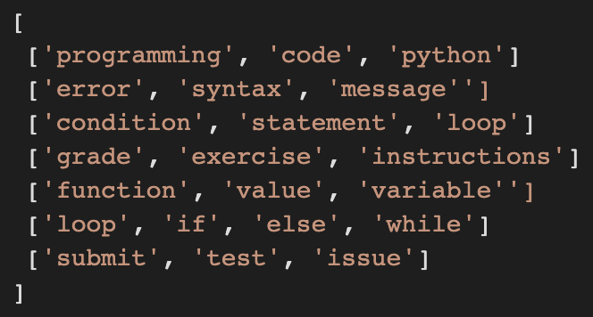
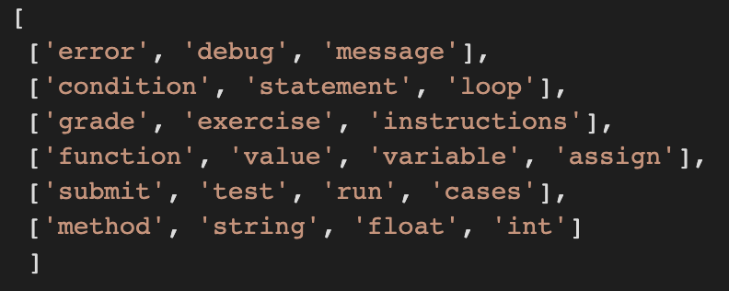
Guided Topic Modeling
Topic Modeling with predefined seeded topics
  Set several seeded topics to which the model will converge towards (assuming the seeded topics are accurate/relevant)
  Provided seeded words for each topic, so each word is related to a specific topic/content
  Recognized the accuracy/specificity of each seeded topic was important -> made topic lists less vague and more narrowed; added potential stop words such as "if", "you", "him", and "thank":
Expectations/Plans:
  Continually try to improve the accuracy of classification by topic through already reliable methods
  Experiment with code and discover more potential methods to increase relevance/accuracy
Before
After
Notes:
Emily
guided (aka seeded) topic modeling
(read first bullet) seeded topics essentially "train" or "guide" our model as an attempt to output more accurate/relevant topics from the discussion forum responses that we were given from the two courses
Seeded topic models pass a collection of keywords to the model, outlining the sought out themes before the estimation
as you can see below, the seeded topic lists are 2-d arrays, where each row is composed of words closely associated with one another, whether they were mentioned in the same discussion forum post, or they had relatively similar meaning
however, once we ran our model with the topic list on the left, the model outputted topics seemingly irrelevant to the course content and didn't help us with potentially indicating student engagement, so we improved this by making our seeded topic list more narrow and adding more stop words such as "if","you","him", and "hello" (stop words are terms we want our model to disregard since they are unimportant words in discussion posts)
"programming" and "code" too vague
as a result, our model began outputting more meaningful and thus more accurate results!
expectations and plans for the rest of the semester (read them)
such as looking at model output, adding more stop words based on the output, discussing with other team members on their approaches that have worked
brainstorm other ideas for improving accuracy, experiment with code by making small changes and seeing how the model's output also changes; gathered that small changes are better than major ones so we know what changes caused what results in order to maximize accuracy

Slide 11
Guided Topic Modeling
<Original>
Yeah.. You would need to use the string methods to see if the strings are ints or floats. You can't use int() or float(). There was a link to useful methods in the lesson, which I'll link here: https://docs.python.org/3.7/library/stdtypes.html#string-methods
Improvement
  Higher Accuracy with more preprocessing
    Narrowed seeded topics down
    Removed tense features(integrating past/present/future tenses)
    Removed URL/email/punctuation, Integrated upper/lower cases
    Deleted irrelevant words by setting them manually
  Instructors can match each post with a specific topic from the topic list
  Generated .json file
Challenges
  Calculate coherence score to see actual improvement
<Preprocessed>
yeah need use string method string int float not use int float link useful method lesson ill link here
<Topic>
['float', 'int', 'string', 'error', 'integer', 'round', 'sort']
Notes:
Harriet
To alter the limitation, we have adapted a guided topic modeling. It guides the topic modeling approach by setting several seed topics to which the model will converge. We will develop this model, and we are going to provide seed words for each topic, so each topic word is related to specific contents. For example, we have four topics as predefined topics in the images. we have tree topic, version topic, grading topic like that. So, we hope to see each document has some other topic. Our expectation is reduction of running time by utilizing pipeline and improvement of accuracy for classification by topic.

Slide 12
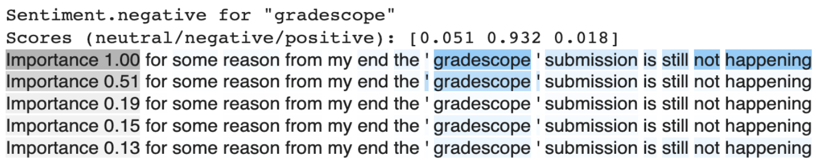
ABSA
Aspect-Based Sentiment Analysis
  Technique that categorizes text data by aspect and identifies the sentiment attributed to each one
  Can provide reasonable sentiment for aspects depending on students’ current circumstance for multiple aspects at once
Tested and trained on Piazza data
  Example input:
    Text: for some reason from my end the ' gradescope ' submission is still not happening
    Aspects: [test, project, quiz, homework, gradescope, assignment]
  Example output:
Notes:
Harriet
Last semester, we worked on Aspect-based sentiment analysis. To give you guys a brief overview, it is a Technique that categorizes text data by aspect and identifies the sentiment attributed to each one. We thought this is efficient to analyze Piazza data, because we can provide reasonable sentiment for aspects depending on students’ current circumstance for multiple aspects at once. As you see on the slide, here is an example text input and output. A student posted that “for some reason from my end the gradescope submission is still not happening.” You can see that the word “gradescope” is acting as a negative word in this text. We used 6 aspects, and for the “Gradescope” aspect, you can see that it is evaluated as “93% negative” from our model.
I will pass the slide to Jisan to talk about our work with topic modeling from the last semester.

Slide 13
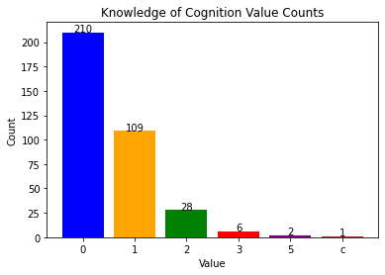
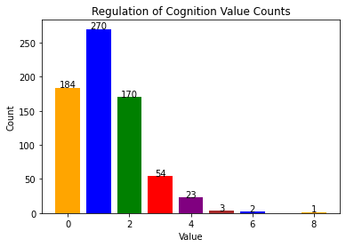
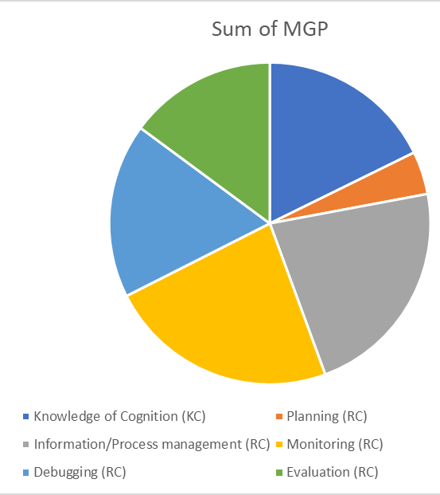
Metacognitive Presence
Knowledge of Cognition (KC) statements includes no activity or action. They basically indicate students' knowledge about a topic of interest or strategy that they have their repository.
Regulation of Cognition (RC) process by which individuals control and manage their cognitive processes, such as Planning Information management. It involves the ability to monitor and modify one's thoughts, feelings, and behaviors in order to achieve specific goals or adapt to changing circumstances.
The visualizations will ideally show the success of the student related to their metacognitive presence
Notes:
Rohan

Slide 14
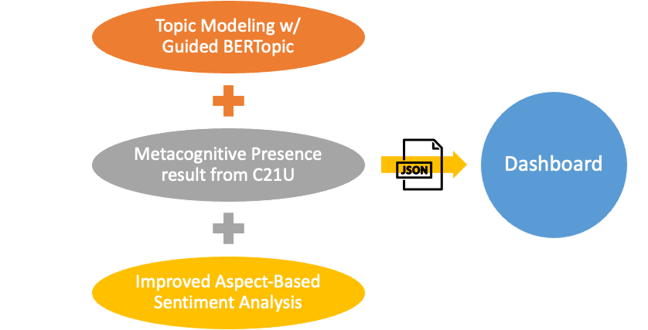
Overall Semester Goals
Notes:
Harriet
Our goal for this semester is to show our result from the data science models to our web page dashboard. So we are going to generate our result as .json file and transfer them to the Web-dev team. Currently, we are dealing with the Ed data from CS1301 class and Piazza data from CS6601 class. As we have presented today, we have been working on topic modeling with guided BERTopic. We have also worked on visualizing the metacognitive presence result we received from C21U research team. We are planning to provide more data from this, and we are on our process of brain-storming which feature we can get from the data. The last thing we are going to do is to improve accuracy of our Aspect-based sentiment analysis model from the last semester and also apply CS1301 dataset to our model.

Slide 15
Web Development

Slide 16
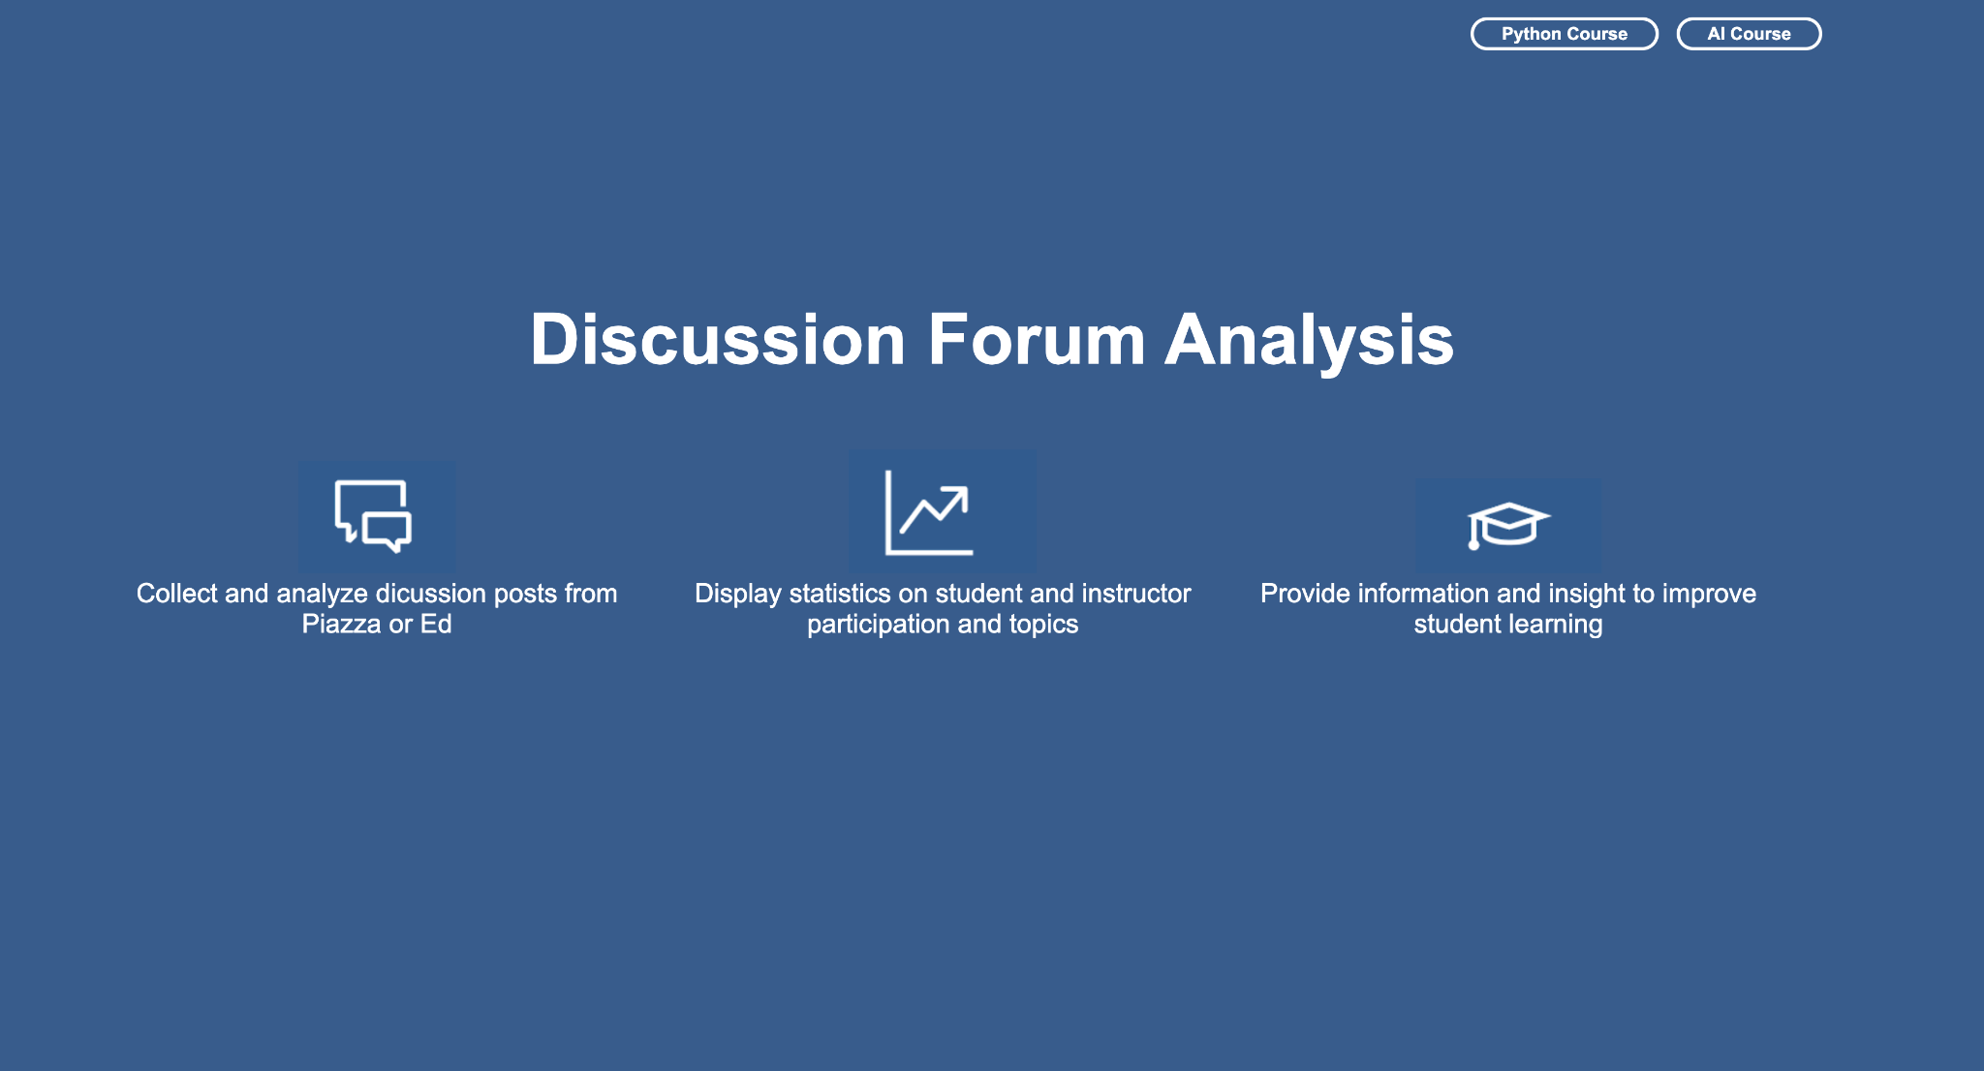
Current Progress
Notes:
Ankit
Youngwook Kang

Slide 17
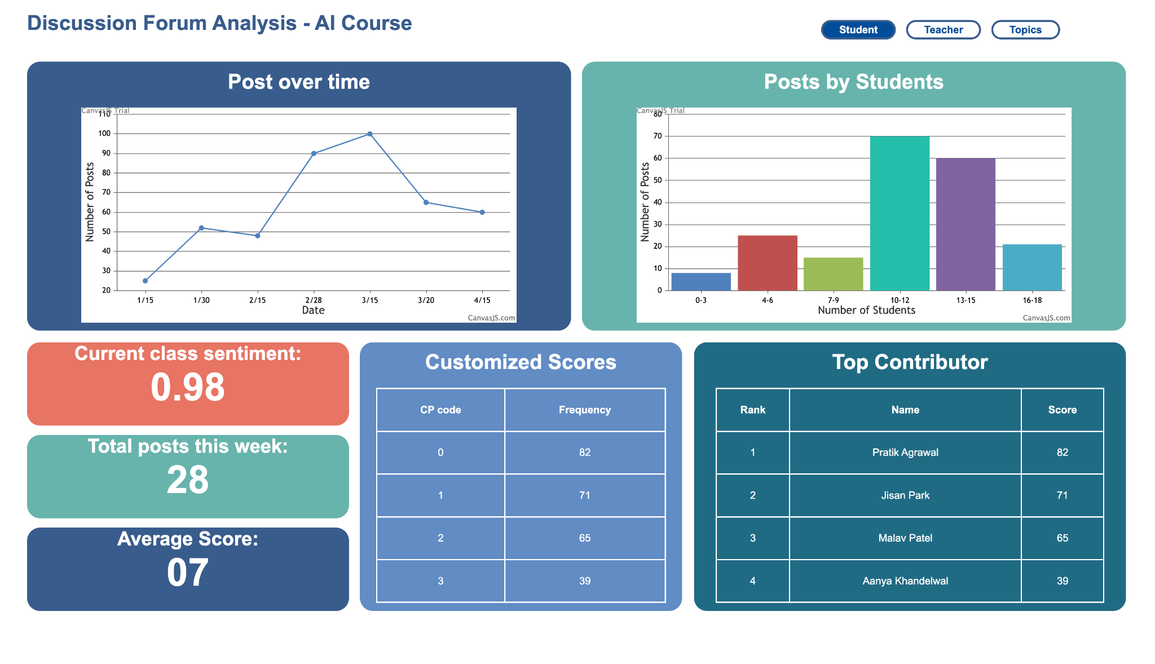
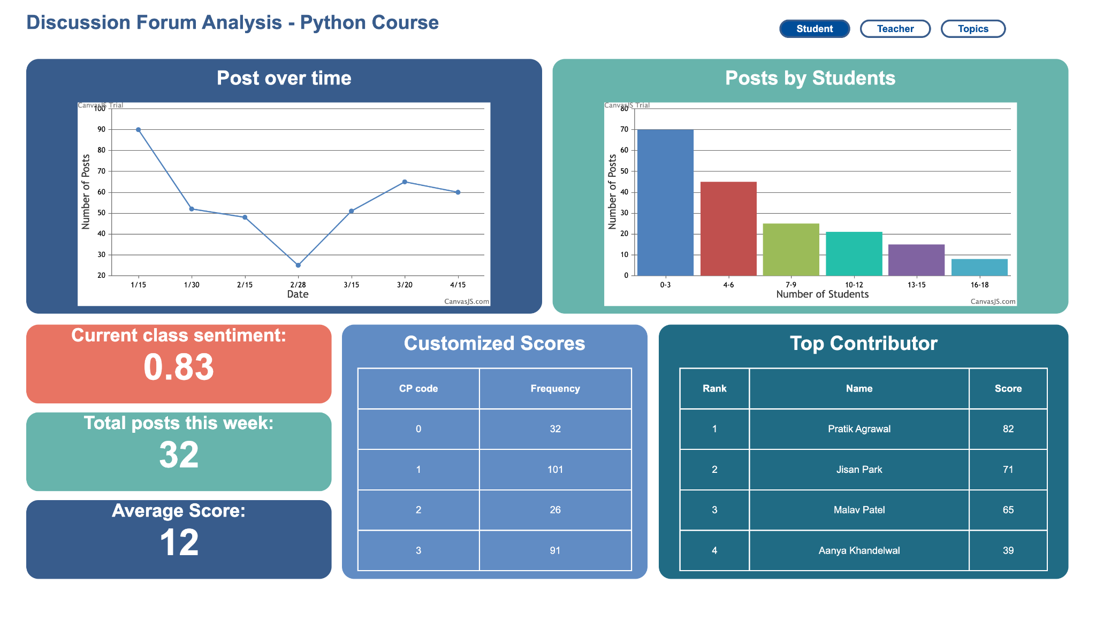
Notes:
Youngwook Kang

Slide 18
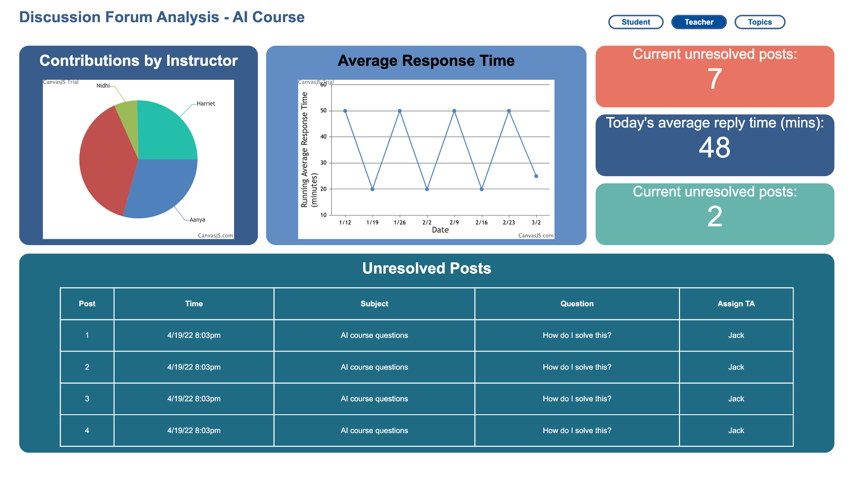
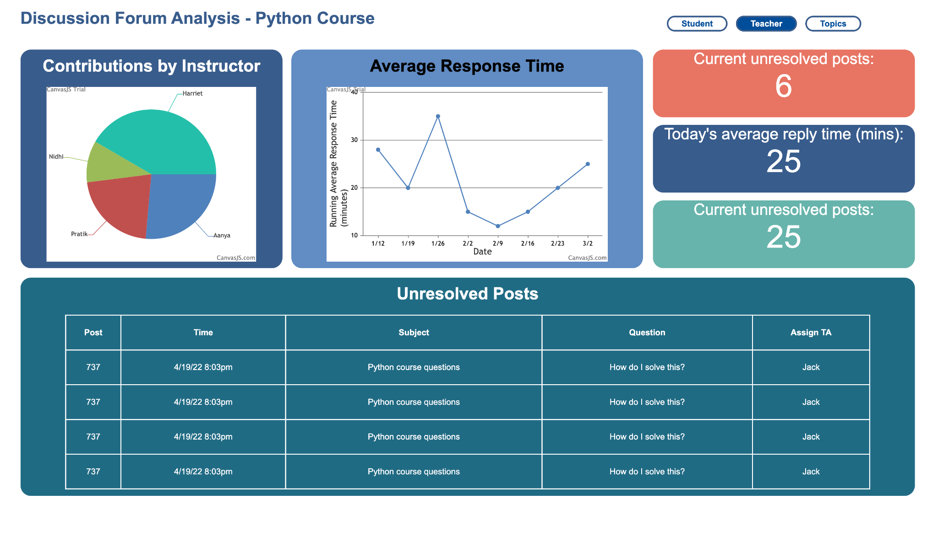
Notes:
Youngwook Kang

Slide 19
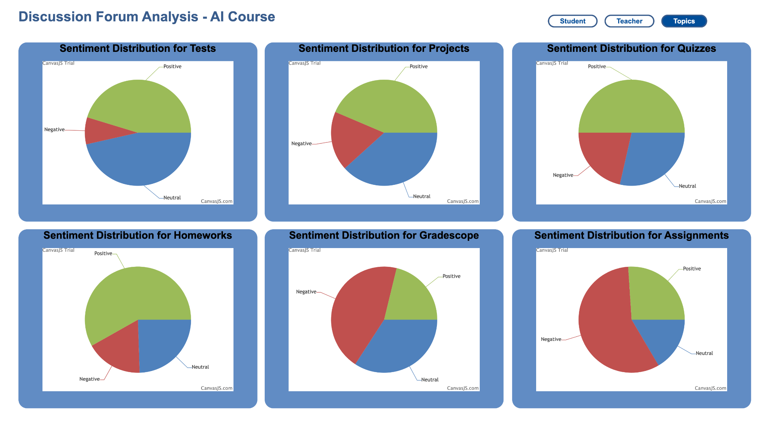
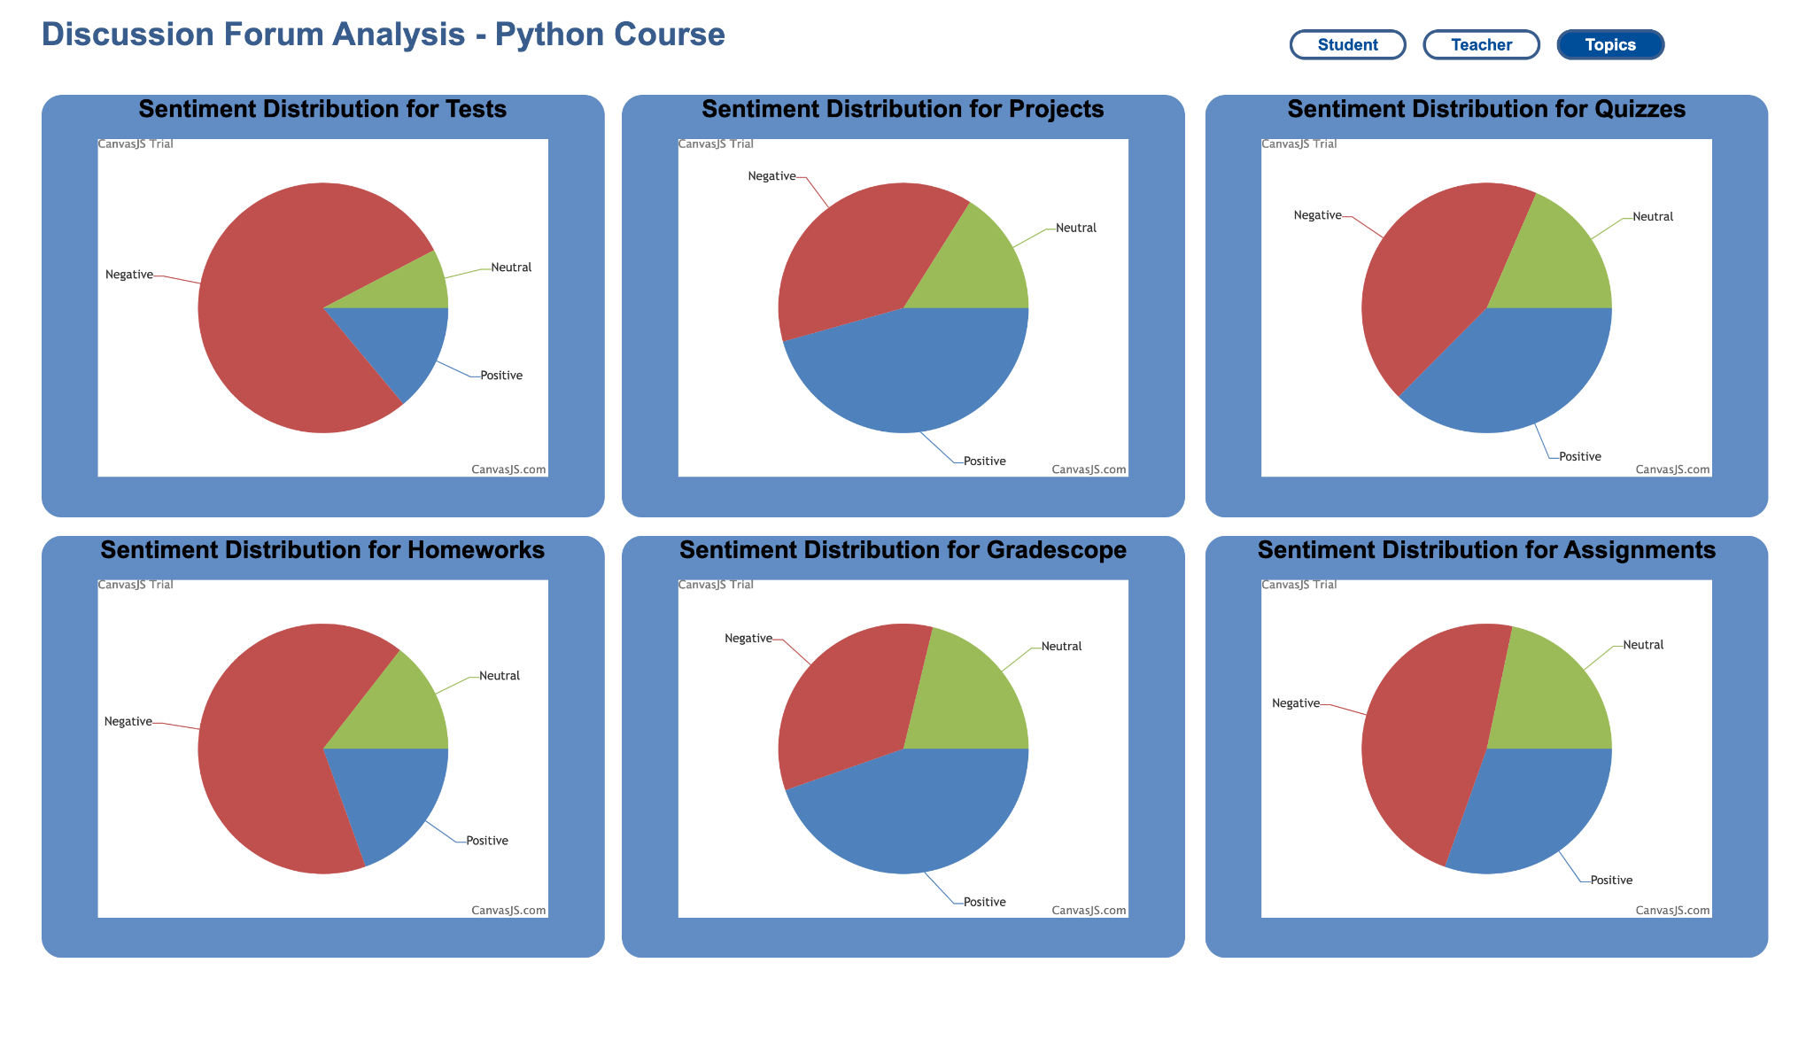
Notes:
Youngwook Kang

Slide 20
Goals for this semester
Make the dashboard responsive so that it can be used on devices of all sizes.
Interview with TAs to find out the datas they find important and update the dashboard to show those information
  Specialize interviews to focus on our tools for this semester, put into use previous interviews
Connect the graphs, tables and all information in the dashboard to the backend data generated by the Data Science team.
problem: we cannot get real time access to Piazza API without instructor’s code. Depending on if we get access to Piazza, we may have to change the student and teacher page informations.
Notes:
Ankit
Youngwook Kang
The web development team aims to create web applications that enhance the learning experience by reducing instructor workload in managing forums and increasing student engagement. To achieve this objective, the backend team is focused on integrating with the Piazza and EdDiscussion APIs, while the front-end team is responsible for designing user interactions and integrating them with metrics from the back-end and data science teams.
This semester, the web development team has set specific goals to achieve their ultimate objective. One of the primary goals is to ensure that dashboards are displayed consistently across all types of displays. Additionally, the team plans to link the current hardcoded information on the dashboard to backend data generated by the Data Science team, thereby providing more accurate and relevant information to users.

Slide 21
Conclusion
Goals
  Complete concrete dashboards for two courses
Future Step
  Seeded Topic Modeling
  Utilize graphical information
  Transfer data outcomes to show to dashboard
  Integrate user feedback by interviewing with TA
  Expand user research to specific applications of dashboards
Notes:
Jisan
For this semester, we are focusing on building the concrete dashboards for each course.
Our Data science team has implemented seeded topic modeling, and they will increase the model for next step. Since the dashboard is not completed yet, they will utilize graphical information and then transfer outcomes to Web-dev team. Web-dev team will get user feedback by interviewing with TA then expand user research to specific applications of dashboards.
Piazza data from ML class, edX data from CS1301

Slide 22
Citations
Peacock, S., & Cowan, J. (2016). From Presences to Linked Influences Within Communities of Inquiry. The International Review of Research in Open and Distributed Learning, 17(5). https://doi.org/10.19173/irrodl.v17i5.2602
Mishra, Ankit, Sugasi Guatam, & Gehani Ritika. (2022). Web Development Team Report. Georgia Tech Vertically Integrated Projects.
Mcdaniel, Rhett. “Metacognition.” Vanderbilt University, Vanderbilt University, 9 Feb. 1970, https://cft.vanderbilt.edu/guides-sub-pages/metacognition/.
“Topic Modeling: A Basic Introduction.” Journal of Digital Humanities, http://journalofdigitalhumanities.org/2-1/topic-modeling-a-basic-introduction-by-megan-r-brett/.
Castellanos-Reyes, D. 20 Years of the Community of Inquiry Framework. TechTrends 64, 557–560 (2020). https://doi.org/10.1007/s11528-020-00491-7
Notes:
Jisan

Slide 23
Questions?
Thanks for listening!
Notes:
Jisan

